Slide 1
LOGISTIC REGRESSION

Slide 2
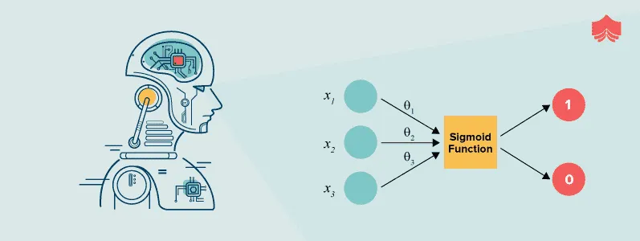
INTRODUCTION
Logistic Regression is a statistical method for analyzing a dataset in which there are one or more independent variables that determine an outcome. It is used for binary classification problems, where the target variable can take only two values, such as "yes" or "no". In Python, there are several libraries that can be used to implement logistic regression, including scikit-learn, statsmodels, and Keras.

Slide 3
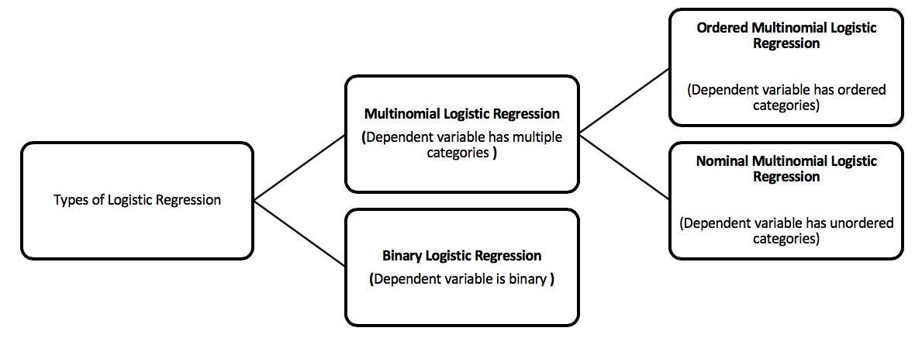
TYPES OF LOGISTIC REGRESSION
Binary
Multinomial (softmax regression, maximal entropy classifier)
Ordinal
Nominal

Slide 4
CONT’D.
Binary Logistic Regression: This is the most basic form of logistic regression, used for predicting a binary outcome (e.g., yes/no, 0/1, true/false).
Multinomial Logistic Regression: This type of logistic regression is used when there are more than two possible outcomes. It is also known as "softmax regression" or "maximal entropy classifier."
Ordinal Logistic Regression: Ordinal logistic regression is used when the outcome variable is ordinal (i.e., it has a natural ordering). For example, rating a product on a scale of 1 to 5.
Nominal Logistic Regression: Nominal logistic regression is used when the outcome variable is nominal (i.e., it has no natural ordering). For example, predicting the type of fruit based on its color and shape.

Slide 5
USES OF LOGISTIC REGRESSION IN REAL LIFE
Healthcare: Logistic Regression can be used to predict the likelihood of a patient developing a particular disease based on certain risk factors such as age, lifestyle, and medical history.
Marketing: Logistic Regression can be used to predict the likelihood of a customer making a purchase based on their demographic information and past purchasing behavior.
Finance: Logistic Regression can be used to predict the likelihood of a loan default based on the borrower's credit history and other financial factors.
Human Resources: Logistic Regression can be used to predict the likelihood of an employee leaving an organization based on factors such as job satisfaction, salary, and job performance.
Education: Logistic Regression can be used to predict the likelihood of a student passing or failing a class based on their previous academic performance, attendance, and other factors.

Slide 6
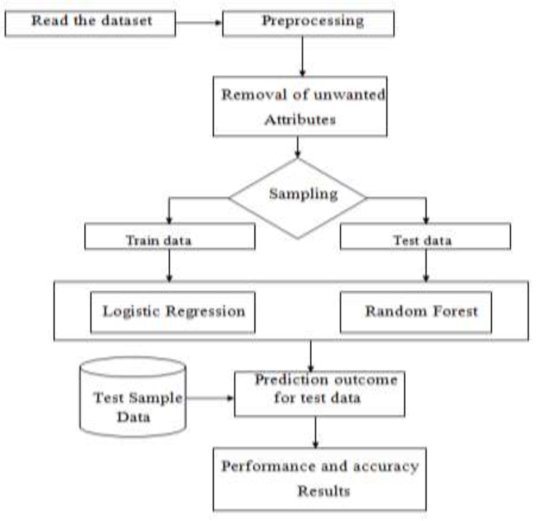
APPLICATION OF LOGISTIC REGRESSION IN THE DETECTION OF FRAUD IN A LIFE INSURANCE SYSTEM
Logistic Regression used in life insurance fraud detection
Fraud types: falsifying info on application, false claims, staged accidents
Insurance companies use Logistic Regression & other techniques to detect fraud
Analyze policyholder data (age, occupation, income, medical history) to predict fraud likelihood
If predicted probability exceeds threshold, claim may be flagged for investigation
Logistic Regression can analyze medical history to detect fraud patterns
Can help identify & prevent fraudulent life insurance claims
Maintains insurance system integrity and protects policyholders

Slide 7
RANDOM FOREST

Slide 8
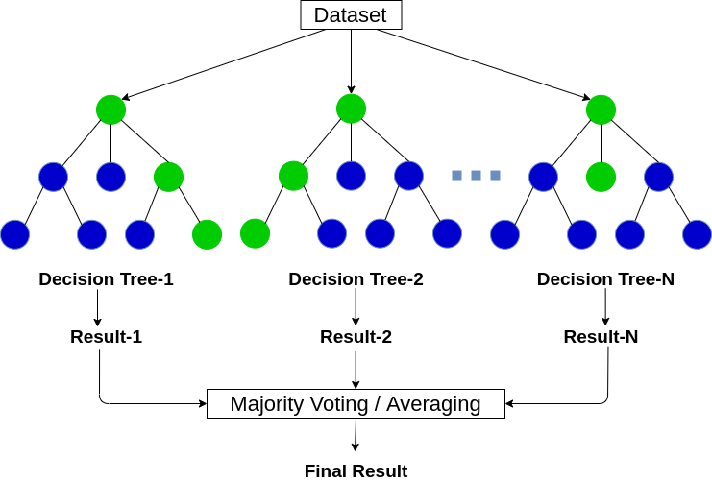
INTRODUCTION
Random forest is a machine learning technique that uses many decision trees to make predictions. It combines these trees in a clever way to make better predictions and avoid mistakes. It is often used to solve problems like deciding if an email is spam or not, predicting a person's age based on their interests, or deciding if a tumor is benign or malignant. This helps to reduce overfitting and improve the accuracy and robustness of the model.

Slide 9
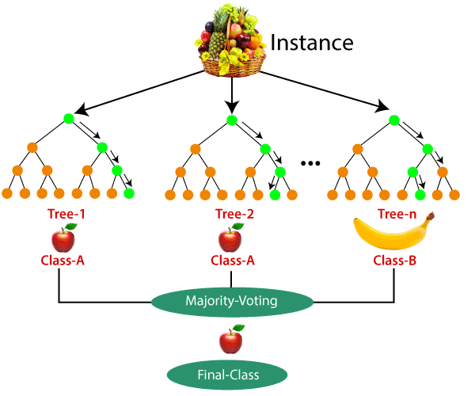
TYPES OF RANDOM FOREST
CLASSIFICATION RANDOM FOREST:
This type of random forest is used for predicting categorical or discrete outcomes. It works by building multiple decision trees, each trained on a different subset of the data, and then combining their predictions to make the final classification.
Eg:You have a dataset of 1,000 customers with age, income, purchase history, and binary label, and you want to predict their purchase behavior based on these variables.

Slide 10
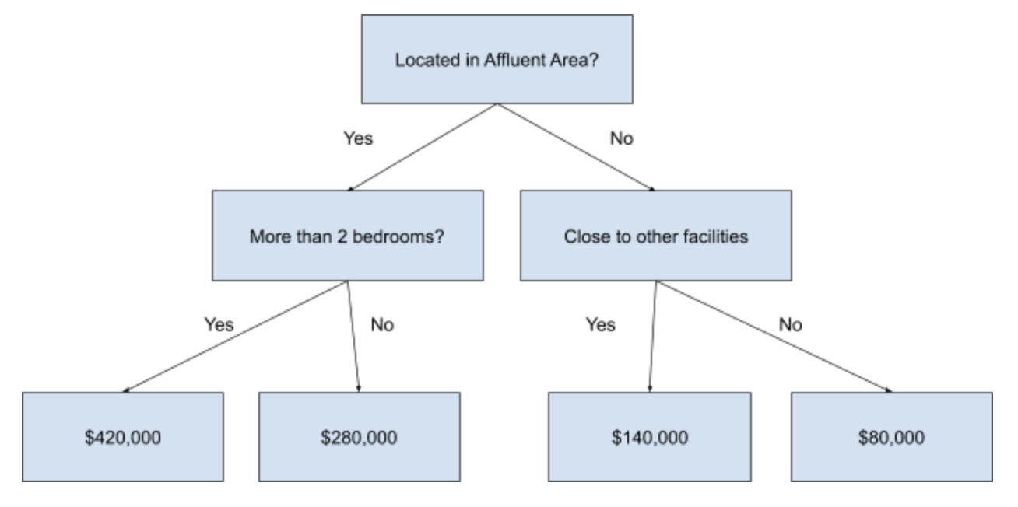
REGRESSION RANDOM FOREST:
This type of random forest is used for predicting continuous or numeric outcomes. It works in a similar way to the classification random forest, but instead of predicting categorical outcomes, it predicts a numerical value based on the inputs.
Eg: There is a dataset of 1,000 houses with size, number of bedrooms, location, and price, you want to predict the price of a house based on those variables.

Slide 11
USES OF RANDOM FOREST IN REAL LIFE
Predictive modeling: used in various fields such as finance, healthcare, and marketing.
Image classification: used in computer vision applications like facial recognition, object detection, and autonomous driving.
Anomaly detection: used to detect anomalies in data such as fraudulent transactions or defective products in manufacturing.
Feature selection: used to identify the most important features in a dataset, which can help reduce dimensionality and improve model performance.
Natural language processing: used for sentiment analysis, document classification, and text summarization.
Recommendation systems: used to predict user preferences and provide personalized recommendations.

Slide 12
APPLICATION OF RANDOM FOREST IN DETECTING FRAUD IN LIFE INSURANCE POLICIES
Random forest can be used to detect fraud in life insurance policies.
It analyzes a set of features related to policyholders and their applications.
It can identify patterns of fraudulent behavior, such as misrepresenting health conditions, lying about personal information, or applying for multiple policies at the same time.
The algorithm considers various features like age, gender, occupation, medical history, policy value, and other relevant data points to make a prediction about the likelihood of fraud.
Using random forest for fraud detection can help life insurance companies reduce the risk of fraudulent claims.
It can minimize financial losses.

Slide 13
BLOCK DIAGRAM
TRAIN
DATASET
DATASET
PRE-PROCESSING
FEATURE
EXTRACTION
RANDOM FOREST
ALGORITHM
Life Insurance details database
Age, Gender, Occupation, Medical history, Policy value
PERFORMANCE ANALYSIS
PREDICTION OF FRAUD
CLASSIFICATION
Policy can be flagged for further examination.

Slide 14
THANK YOU

